Slide 1


Exploring Inclusive Employment in the Green Economy
Alexis Buettgen, PhD
VRAIE/IDEA
Speaker Series Presentation*
May 31, 2024

Slide 2

Acknowledgements & Gratitude
Mitacs co-funding postdoc with IDEA & Institute for Work & Health
Emile Tompa (supervisor extraordinaire!)
IWH staff Emma, Maggie, & Joanna
McMaster University Department of Economics
All interview participants for their time and contributions
Katherine Lofts (research assistant)

Slide 3
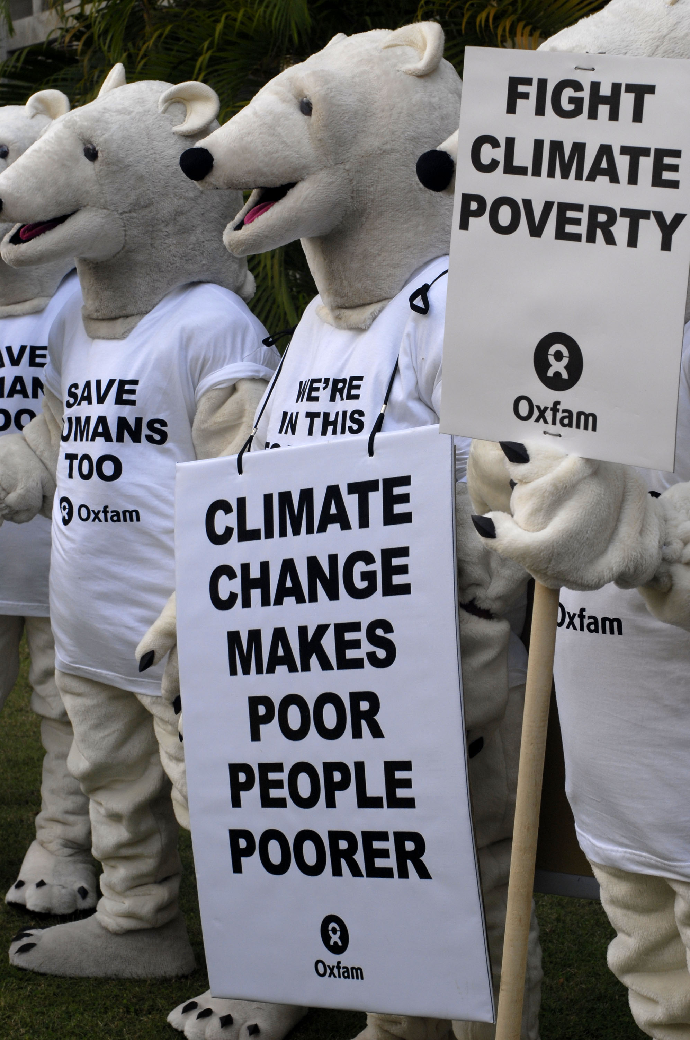
Background & Context
Profound poverty and low employment rates among people with disabilities
Disproportionate impacts of climate change
Need to shift toward sustainable economic development
Limited knowledge about disability inclusion in the emerging green economy and green jobs
Photo credit: Oxfam International – Polar bears fight climate poverty

Slide 4
What does “Green Economy” mean to you?
Please use the chat

Slide 5
What does “Green Jobs” mean to you?
Please use the chat

Slide 6
Research Questions
What are the challenges, barriers and opportunities for inclusion of persons with disabilities in the green economy?
What is the current state of the scholarly literature on disability inclusion in the green economy?
What programs, policies and initiatives can support sustainable and equitable participation in the green economy?

Slide 7
Methodology
Evidence synthesis approach
Critical disability theoretical framework
Methods
  Scoping review (n=21)
  Qualitative interviews (n=18)
  Environmental scan (~ 30)
Geographic scope: Global North with a focus on Canada

Slide 8
Challenges & Barriers
Current structure of work and employment is inherently problematic
  e.g., lack of access to education and relevant skills; entry level and potentially hazardous green jobs; prevalence of charity model;
  Few examples of disability inclusive employment = largely untapped potential to harness creativity and socially inclusive green economic development
  Risk of dependence on financial incentives for employment of persons with disabilities

Slide 9

Challenges & Barriers (cont’d)
Dialogic and functional “silos”
  Between government departments and agencies
  Between ESG initiatives
  Between and within movements
Lack of meaningful investment in disability inclusion
  “Rhetoric isn't enough to change the climate and it's not enough to sustain a business”
  Also reflected in dearth of literature and research

Slide 10
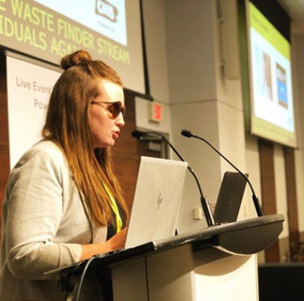
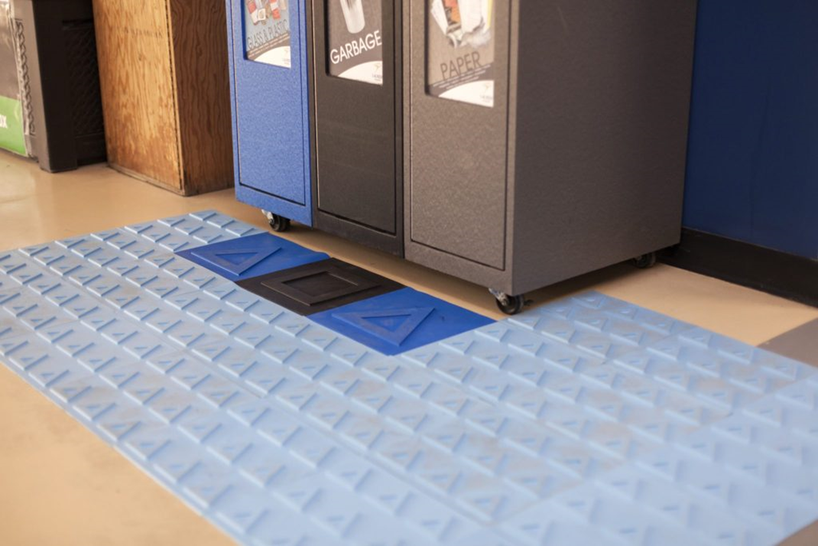

Bridging the gap between sustainability and accessibility

Slide 11
Employment Opportunities
Green jobs
  Leverage $$ going into disability and employment and “green solutions”
  Employers receptive of changes in the world of work
  Sustainable business models (e.g., triple bottom line: People, planet, profit)
“Respecting the environment, society, community, people and also thinking about social impact and not just generating revenues…So for me, a green job is receptive of changes of individual needs and adjusting for reasonable accommodation, flexibility, adaptability.” (Joe)
However…
“We cannot just assume that every green job is a decent job and it’s important to ensure that green jobs also meet those [decent] job requirements.” (Sidney)

Slide 12

Specializing in life cycle management of professional IT and mobile equipment, from deployment to reuse through operational maintenance.
Promotes employment, professionalization and social inclusion of people with disabilities.

Slide 13


Policy Opportunities
Human rights, law and policy
  CRPD, Paris Agreement, SDGs
  Built environment regulations are “low hanging fruit”
  Increasing mentions of persons with disabilities

Slide 14
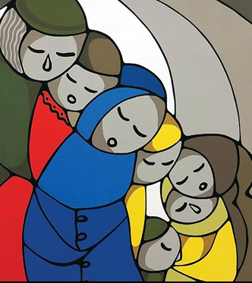
Conceptual Opportunities
Cultural shifts: Wellness and collective care
  Collective care and support for living in a hostile world is work already underway by people with disabilities, Indigenous people, and other historically marginalized groups
  Opportunities to advance the care economy

Slide 15
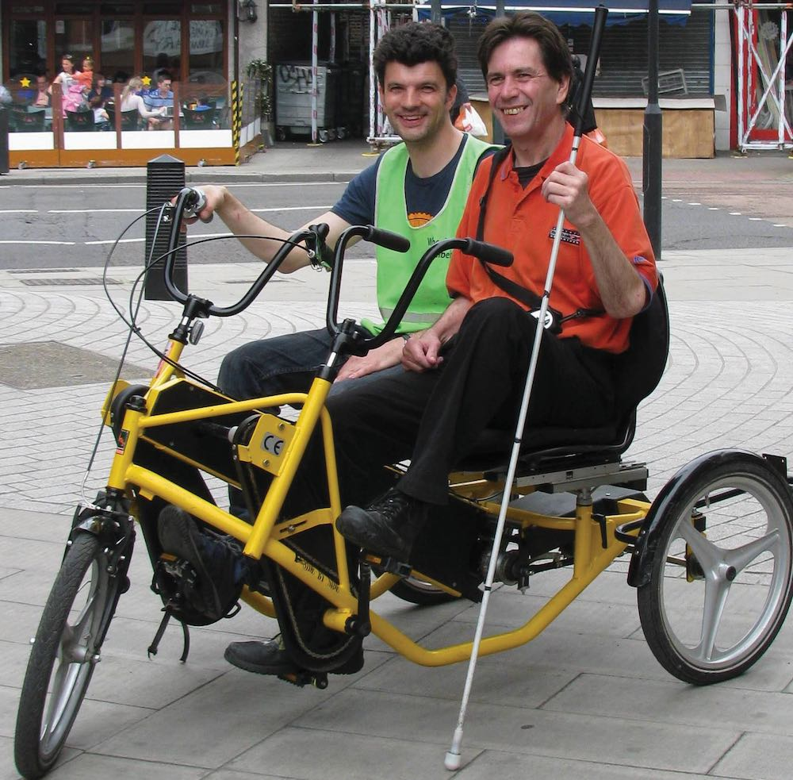

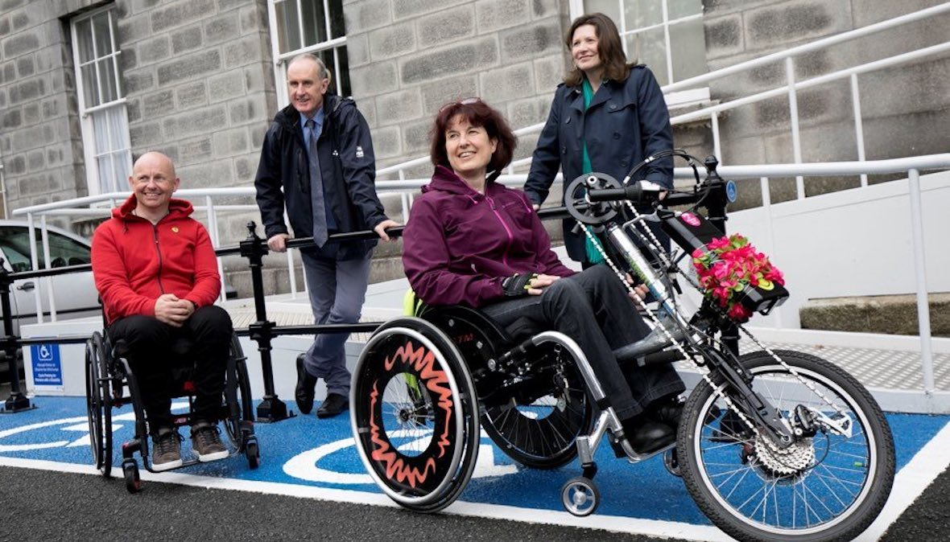
Removing barriers to cycling informed by personal experience of trustees, staff and volunteers with disabilities.

Slide 16
Preliminary Conclusions
There is opportunity NOW to make the green economy and green jobs inclusive
Disabled experiences and epistemologies MUST be central to the design, planning and implementation of the emerging green economy using inclusive design principles.
Implementing a just transition to a green economy will require an integrated mix of employment standards, social protection, skills development, and attitudinal transformation.

Slide 17
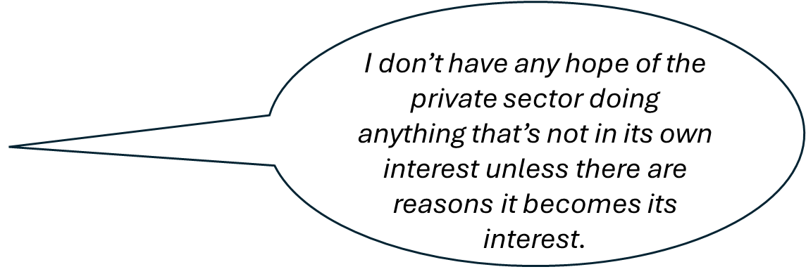
Preliminary Recommendations
Researchers:
  Theoretically informed empirical research within a transformative paradigm
  Critical policy analysis of just transition and sustainable jobs plans
Policy makers:
  Multistakeholder governance with a focus on decent work
  Collaborative cross-sector local workforce development processes
  Mandates and regulations/requirements for disability inclusion in climate financing, procurement
  Leverage existing incentives
Employers:
  Showcase promising practices/initiatives
  Skepticism abounds

Slide 18
Questions Remaining & for Discussion
Is it possible to realize a disability inclusive green economy and green jobs in a capitalist political economy? What would this look like?
What role can we play in contributing toward inclusive employment in a green economy?
  How have you considered the intersection between disability inclusion and environmental sustainability in your work?
  What opportunities can you leverage to advance knowledge and practice at this intersection?

Slide 19
Key References & Resources
Alonso-Martínez, D., Jiménez-Parra, B., & Fernández-Gago, R. (2021). Disability as a Driving Force of Sustainable Business Models in the Fourth Sector. Studies on Entrepreneurship, Structural Change and Industrial Dynamics, 75-97. https://doi.org/10.1007/978-3-030-68390-0_5
Angelini, C., Lombardo, E., & Pignatel, I. (2013). An Innovative Perspective on Disability at ATF GAIA and ESAT Les Palmiers. Global Business and Organizational Excellence, 32(4), 59-68. https://doi.org/10.1002/joe.21495
Bruyére, S., & Filiberto, D. (2013). The green economy and job creation: Inclusion of people with disabilities in the USA. International Journal of Green Economics, 7(3), 257-275. https://doi.org/10.1504/IJGE.2013.058151
Ceballos, D. M., Côté, D., Bakhiyi, B., Flynn, M. A., Zayed, J., Gravel, S., Herrick, R. F., & Labrèche, F. (2020). Overlapping vulnerabilities in workers of the electronics recycling industry formal sector: A commentary. American Journal of Industrial Medicine, 63(11), 955-962. https://doi.org/10.1002/ajim.23173
Jodoin, S., Ananthamoorthy, N., & Lofts, K. (2021). A disability rights approach to climate governance. Ecology Law Quarterly, 47(1), 73-116. https://doi.org/10.15779/Z38W37KW48
Stein, P. J. S., & Stein, M. A. (2022). Disability, Human Rights, and Climate Justice. Human Rights Quarterly, 44(1), 81-110. https://doi.org/10.1353/hrq.2022.0003

Slide 20
Key References & Resources (cont’d)
VanWynsberghe, R. (2016). Green jobs for the disadvantaged in British Columbia: the perspectives of non-governmental organisations and social entrepreneurs. Local Environment, 21(4), 504-526. https://doi.org/10.1080/13549839.2014.974151
Vogelauer, C., Herold, D. M., & Fuerst, E. (2020). The role of disability and accessibility in corporate sustainability reporting. International Journal of Disability Management. https://doi.org/10.1017/idm.2020.6
ATF Gaia: https://www.atf-gaia.fr/fr/atf-gaia
Wheels for Wellbeing. https://wheelsforwellbeing.org.uk/
Previous resources about STIL Solutions:
https://www.youtube.com/watch?v=6ox9ioF_UvI
https://cleanriver.com/resource/blog-accessible-recycling-bins-sustainability-solutions/
https://researchcentres.wlu.ca/viessmann-centre-for-engagement-and-research-in-sustainability/assets/documents/stil-report-city-kitchener-2022

Slide 21
Thank you!
Alexis Buettgen, PhD (she/her)
Postdoctoral Fellow | DeGroote School of Business
Assistant Clinical Professor (Adjunct) | School of Rehabilitation Science
McMaster University
Adjunct Faculty | Critical Disability Studies Program
York University
Email: buettgea@mcmaster.ca; a.buettgen@gmail.com
LinkedIn: www.linkedin.com/in/alexis-buettgen-56b2b3145/
*Please do not share, publish or otherwise use these slides without the permission of the author.

